Slide 1
Luke 13:1-9
(English Standard Version)

Slide 2
13 There were some present at that very time who told him about the Galileans whose blood Pilate had mingled with their sacrifices. ² And he answered them, “Do you think that these Galileans were worse sinners than all the other Galileans, because they suffered in this way? ³ No, I tell you; but unless you repent, you will all likewise perish. ⁴ Or those eighteen on whom the tower in Siloam fell and killed them: do you think that they were worse offenders than all the others who lived in Jerusalem? ⁵ No, I tell you; but unless you repent, you will all likewise perish.”

Slide 3
⁶ And he told this parable: “A man had a fig tree planted in his vineyard, and he came seeking fruit on it and found none. ⁷ And he said to the vinedresser, ‘Look, for three years now I have come seeking fruit on this fig tree, and I find none. Cut it down. Why should it use up the ground?’ ⁸ And he answered him, ‘Sir, let it alone this year also, until I dig around it and put on manure. ⁹ Then if it should bear fruit next year, well and good; but if not, you can cut it down.’ ”

Slide 4
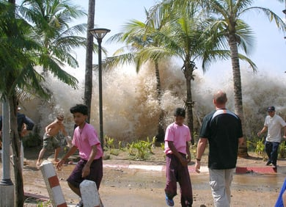
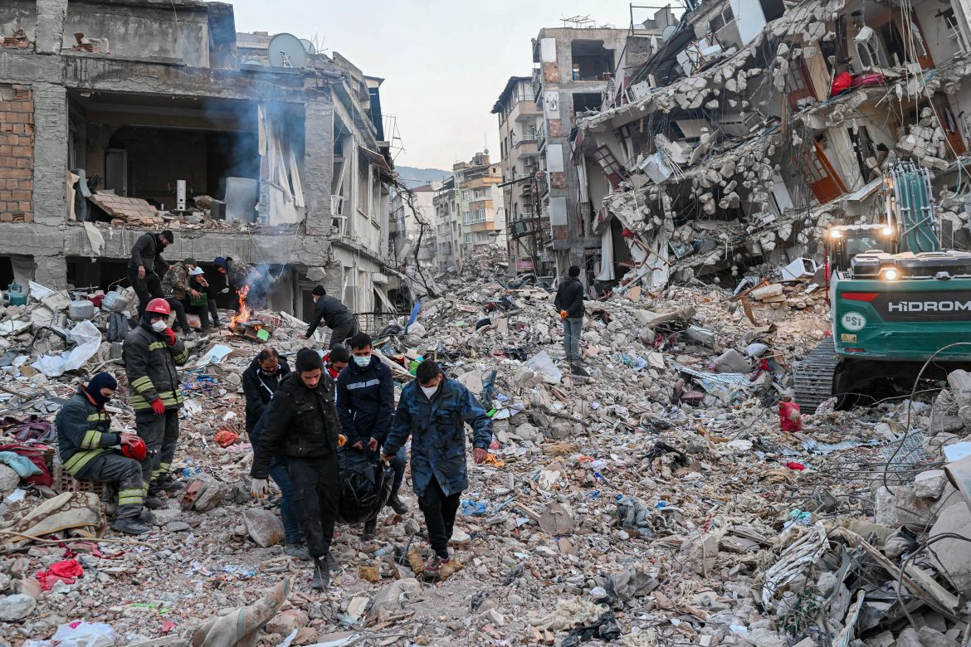
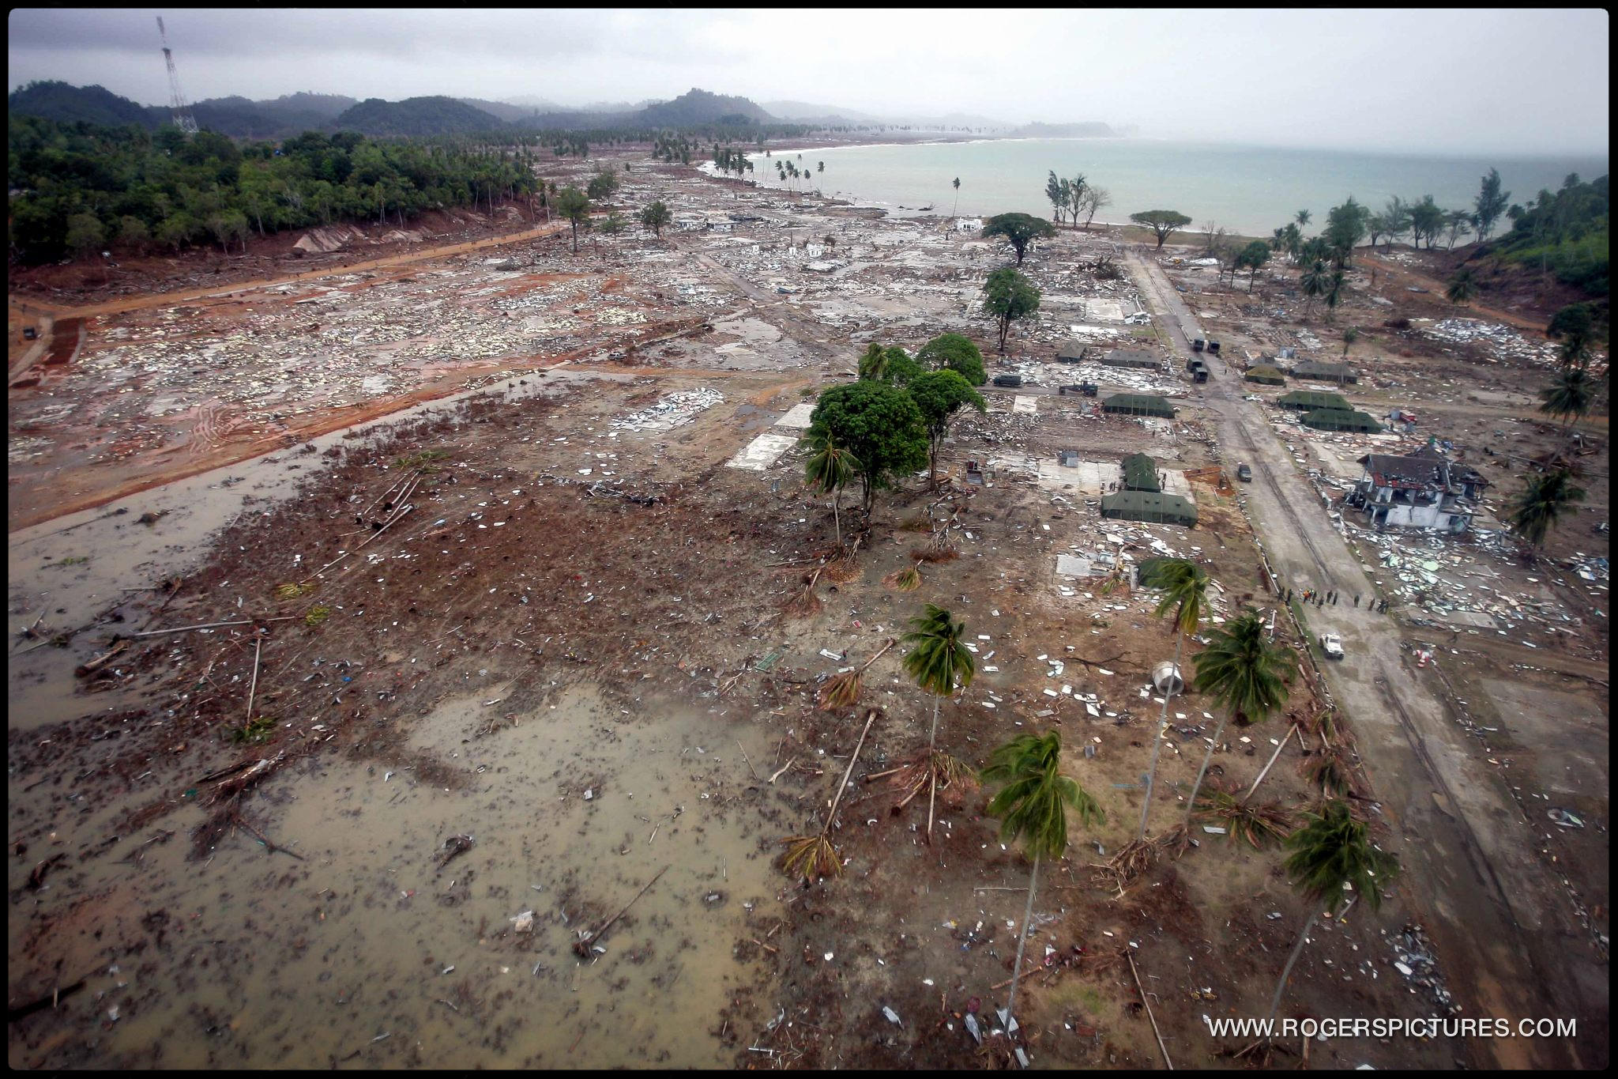
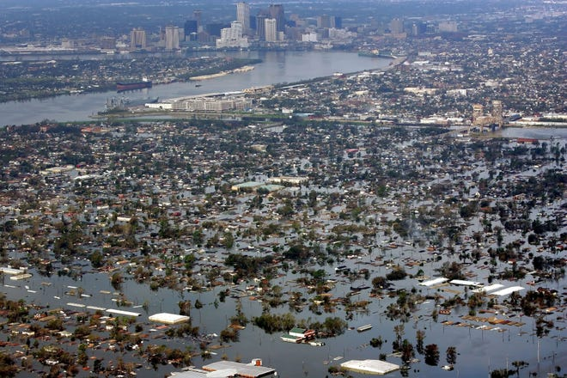

Slide 5
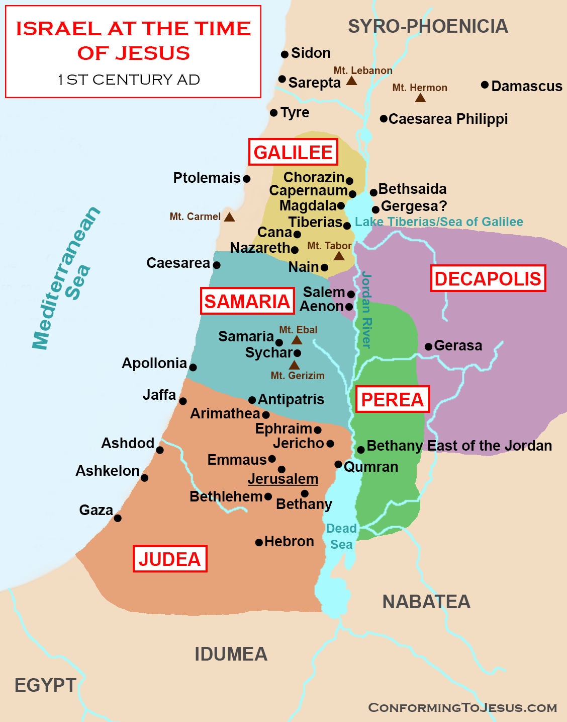
Finding Meaning in Tragedy
Tragedy 1 – Galileans making an offering to God were killed by Pilate
The (Southern) Judeans were prejudiced against the (Northern) Galileans. Assumed they deserved the judgment of God

Slide 6
Finding Meaning in Tragedy
Tragedy 1 – Galileans making an offering to God were killed by Pilate
The (Southern) Judeans were prejudiced against the (Northern) Galileans. Assumed they deserved the judgment of God
“They were not worse sinners than you are” – “Unless you repent, you will all perish”
Tragedy 2 – The tower of Siloam collapsed in Jerusalem, killing 18
Jesus cuts through the prejudice – “Unless you repent, you will perish”
“Do you think that these Galileans were worse sinners than all the other Galileans, because they suffered in this way? ³ No, I tell you; but unless you repent, you will all likewise perish. ⁴ Or those eighteen on whom the tower in Siloam fell and killed them: do you think that they were worse offenders than all the others who lived in Jerusalem? ⁵ No, I tell you; but unless you repent, you will all likewise perish.”

Slide 7
Finding Meaning in Tragedy
Tragedy 1 – Galileans making an offering to God were killed by Pilate
The (Southern) Judeans were prejudiced against the (Northern) Galileans. Assumed they deserved the judgment of God
“They were not worse sinners than you are” – “Unless you repent, you will all perish”
Tragedy 2 – The tower of Siloam collapsed in Jerusalem, killing 18
Jesus cuts through the prejudice – “Unless you repent, you will perish”
Sinners – The Rejection of God
Offenders – Debtors – When I sin against God, there is a price to be paid (an impossible debt)
Perish – apoleisthe (Apollyon) – to be destroyed. Hopeless eternal death.
Repent – To turn from sin and toward faith in Jesus. Stop living for self & follow Jesus.
When tragedy strikes: Do not apportion blame. Ask “If it happened to me, would I be ready?”
Unless I repent, I also will perish (An eternal fate worse than death).
Only repentance to faith in the Lord Jesus Christ can save us from perishing.
“Do you think that these Galileans were worse sinners than all the other Galileans, because they suffered in this way? ³ No, I tell you; but unless you repent, you will all likewise perish. ⁴ Or those eighteen on whom the tower in Siloam fell and killed them: do you think that they were worse offenders than all the others who lived in Jerusalem? ⁵ No, I tell you; but unless you repent, you will all likewise perish.”

Slide 8
Finding Meaning in Tragedy
Jesus cuts through the prejudice – “Unless you repent, you will all perish”
Sinners – The Rejection of God
Offenders – Debtors – When I sin against God, there is a price to be paid (an impossible debt)
Perish – apoleisthe (Apollyon) – to be destroyed. Hopeless eternal death.
Repent – To turn from sin and toward faith in Jesus. Stop living for self & follow Jesus.
When tragedy strikes: Do not apportion blame. Ask “If it happened to me, would I be ready?”
Unless I repent, I also will perish (An eternal fate worse than death).
Only repentance to faith in the Lord Jesus Christ can save us from perishing.
The mercy of God – He delays judgment. Giving opportunity to repent. His patience will end.
Fig tree represents Israel – God’s chosen & privileged people. But they bore no fruit for God.
The Justice of God – “I will chop the tree down”
The Mercy of God – “I will give it more time. Tend it & fertilise it. But time is limited.
A message for us:
A call to repentance.
To be fruitful is to recognise our need to be saved, and to respond in repentance.
God determined our time and our place of living, to encourage us to seek Him. Waiting for us to reach out in faith

